Slide 1
Computational tools

Slide 2
Final Project Docs
README file - briefly describes the files in the repository. Information should include the name of the file and the type of file it is, i.e. data file, lab notebook, data dictionary, driver script, etc.
Data File - If you synthesized your own data, please copy it to a file and it include it in the repository. If the data is too big to include here, please mention that in the README file and provide a link to it if possible.
Data Dictionary - This should include the variable names, descriptions (what the variables represent and the possible values they can take) and types. Be sure to include if a variable was a predictor or outcome of interest, and if it is binary, categorical, continuous, etc.

Slide 3
Final Project Docs
Lab Notebook - This file should contain the text for the abstract, introduction, methods, results and conclusion sections as well as all code used during analysis. This document should also include any tables, figures or other visuals. Remember to comment your code.
Driver Script - If you have created a driver script that runs separate files and produces some output, please provide it with details of what files are being run and why.
Final Presentation - This can be a powerpoint presentation, beamer presentation, etc.

Slide 4
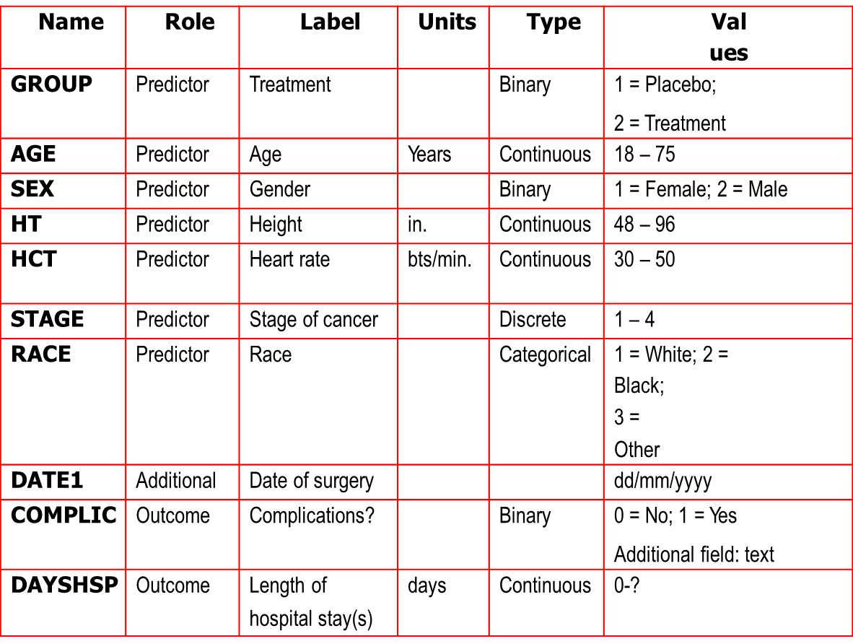
Data Dictionary

Slide 5
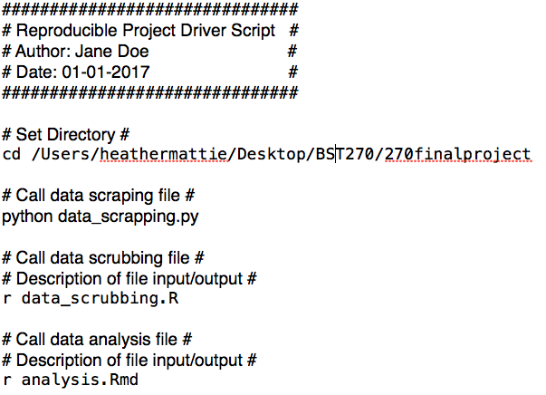
Driver Script

Slide 6
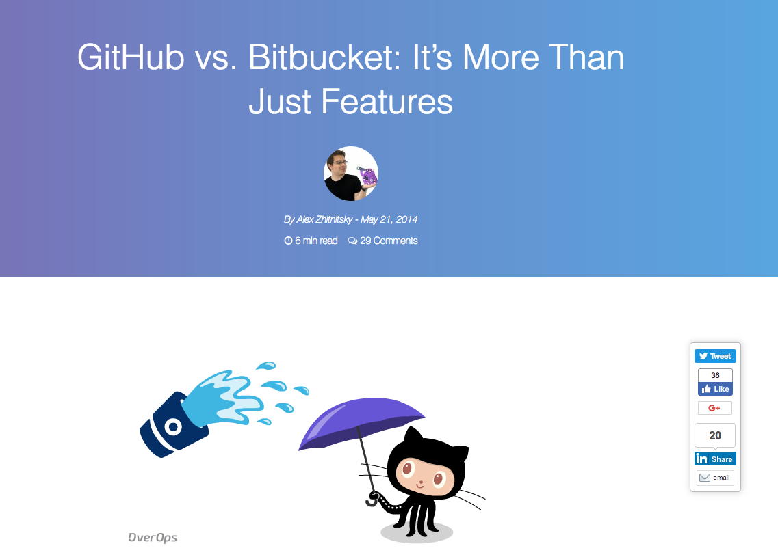
GitHub vs BitBucket

Slide 7
GitHub vs Bitbucket
Does my code have to be public?
No, you’ll get free private repositories on Bitbucket and pay for them on GitHub
Where is it easier to work on open-source projects?
GitHub is the undisputed home for open-source
Which is more popular?
GitHub. As of February 2017, there are over 20M GitHub users and 6M Bitbucket users
What about pricing?
The price varies according to your needs, but both offer similar price tags.

Slide 8
GitHub vs Bitbucket
Will my repositories be visible/showcased?
Bitbucket has a simple search tool, so unless someone is specifically looking for your project, it won’t be found
GirHub boasts trending repos and showcases popular topics, not to mention its use as a portfolio for developers and an open job board
Where do they stand with community support?
GitHub is MILES ahead.
Can I switch between the two?
Yes. Bitbucket makes it pretty straightforward to import your repositories from GitHub. However, it’s a little more complicated the other way around

Slide 9
GitHub Glossary https://help.github.com/articles/github-glossary/
Git: an open source program for tracking changes in text files. It was written by the author of the Linux operating system, and is the core technology that GitHub, the social and user interface, is built on top of.
Repository: a repository is the most basic element of GitHub. They're easiest to imagine as a project's folder. A repository contains all of the project files (including documentation), and stores each file's revision history. Repositories can have multiple collaborators and can be either public or private.
Private repository: private repositories are repositories that can only be viewed or contributed to by their creator and collaborators the creator specified.

Slide 10
GitHub Glossary
Clone: a clone is a copy of a repository that lives on your computer instead of on a website's server somewhere, or the act of making that copy. With your clone you can edit the files in your preferred editor and use Git to keep track of your changes without having to be online. It is, however, connected to the remote version so that changes can be synced between the two. You can push your local changes to the remote to keep them synced when you're online.
Fork: a fork is a personal copy of another user's repository that lives on your account. Forks allow you to freely make changes to a project without affecting the original. Forks remain attached to the original, allowing you to submit a pull request to the original's author to update with your changes. You can also keep your fork up to date by pulling in updates from the original.

Slide 11
GitHub Glossary
Fetch: fetching refers to getting the latest changes from an online repository without merging them in. Once these changes are fetched you can compare them to your local branches (the code residing on your local machine).
Commit: a commit, or "revision", is an individual change to a file (or set of files). It's like when you save a file, except with Git, every time you save, it creates a unique ID (a.k.a. the "SHA" or "hash") that allows you to keep record of what changes were made when and by who. Commits usually contain a commit message which is a brief description of what changes were made.

Slide 12
GitHub Glossary
Push: pushing refers to sending your committed changes to a remote repository, such as a repository hosted on GitHub. For instance, if you change something locally, you'd want to then push those changes so that others may access them.
Pull requests: pull requests are proposed changes to a repository submitted by a user and accepted or rejected by a repository's collaborators. Pull requests each have their own discussion forum.
Merge: merging takes the changes from one branch (in the same repository or from a fork), and applies them into another. This often happens as a pull request (which can be thought of as a request to merge), or via the command line. A merge can be done automatically via a pull request via the GitHub web interface if there are no conflicting changes, or can always be done via the command line.

Slide 13
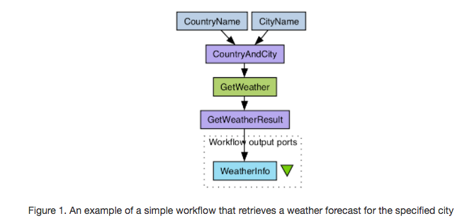
Taverna

Slide 14
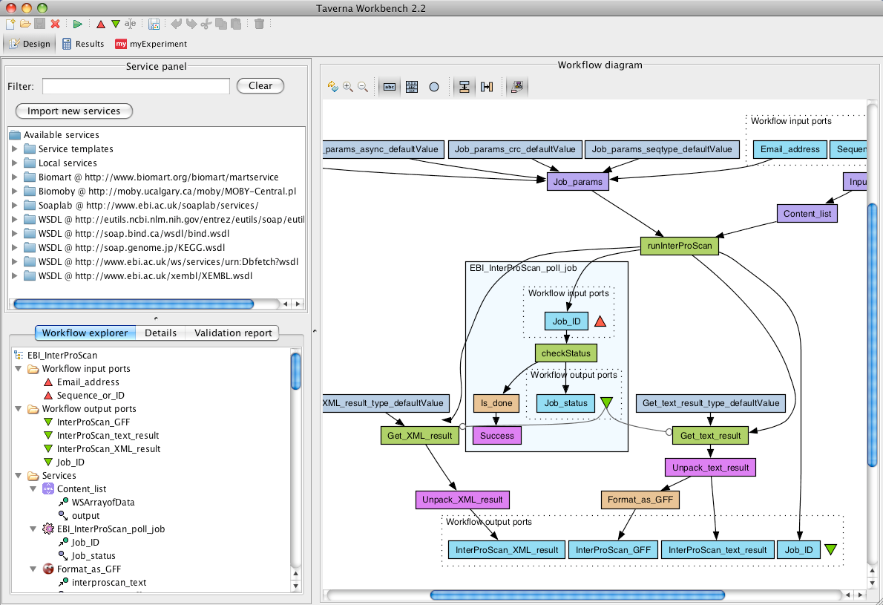
Taverna

Slide 15
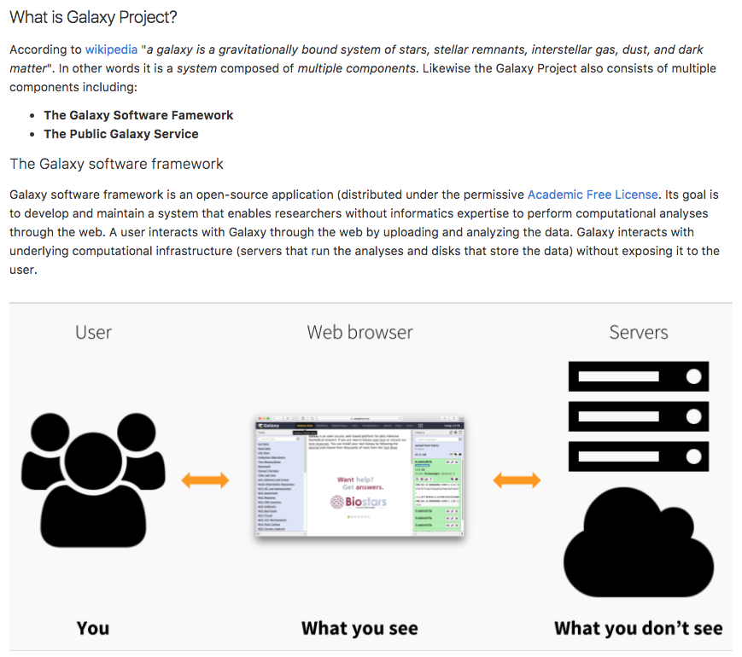
Galaxy

Slide 16
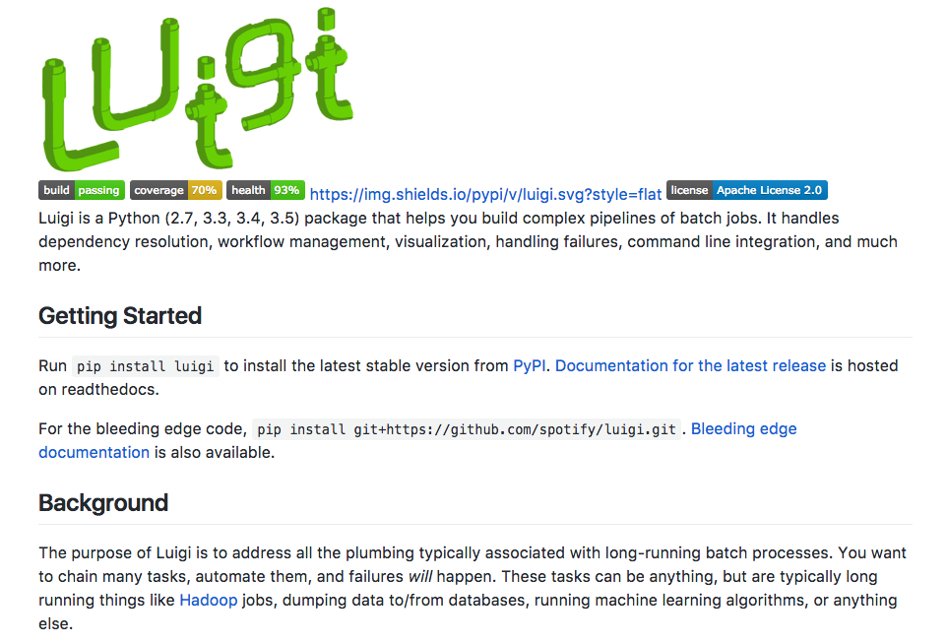
Luigi https://github.com/spotify/luigi

